Slide 1
Clustering

Slide 2
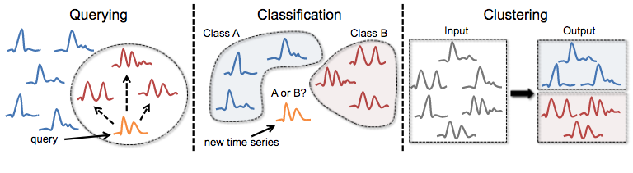
Time series clustering applications
The election of the right distance measure is key for the results.

Slide 3
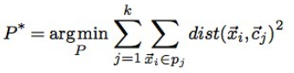
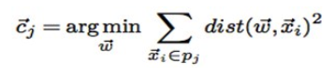
K-Means: Classical time-series clustering
Target: Find the partition of time series P* that minimizes the sum of squared distances between time series and centroids.
K-Means finds a locally optimal solution by iteratively performing two steps:
Assignment step: assigns time series to its nearest centroids. (a distance function)
Refinement step: updates centroids w.r.t. all its time-series members. (centroid computation method)

Slide 4
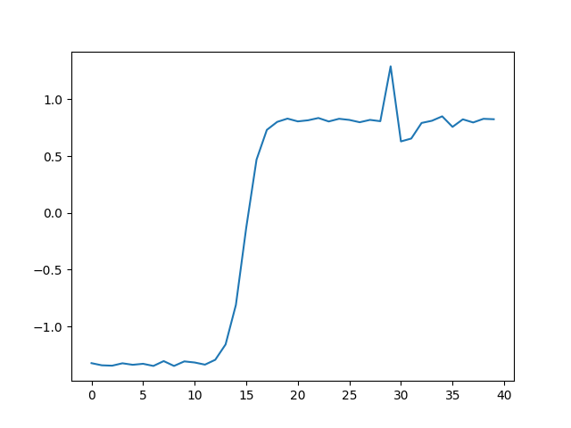
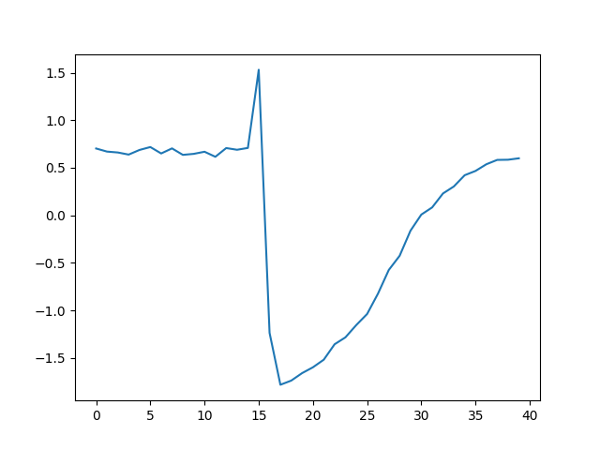
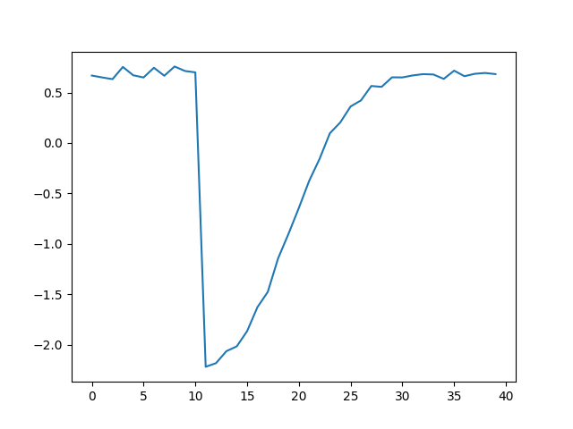
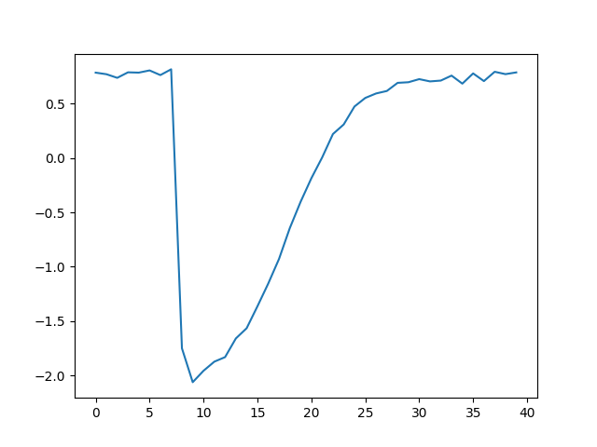
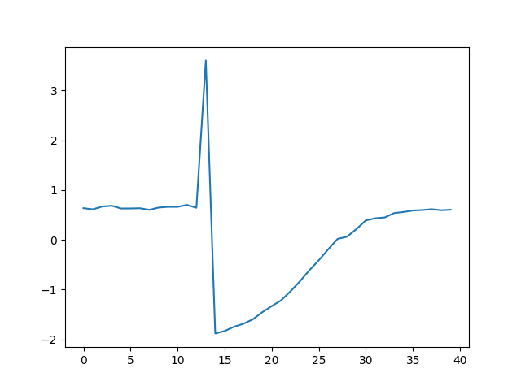
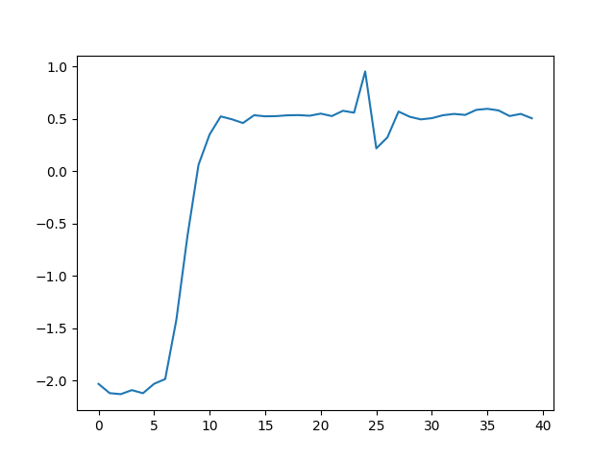
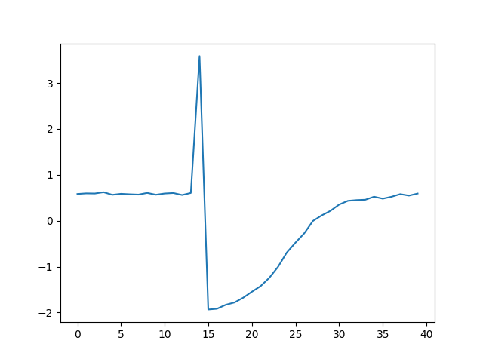
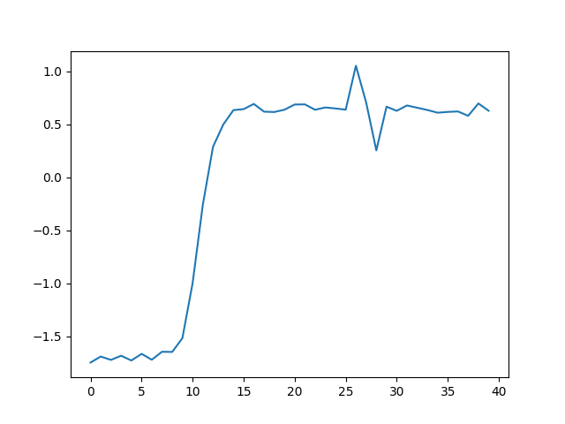
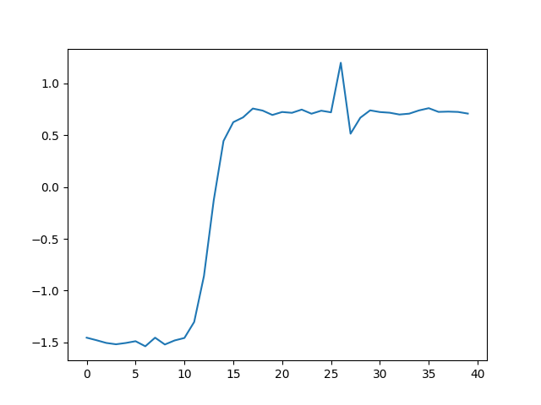
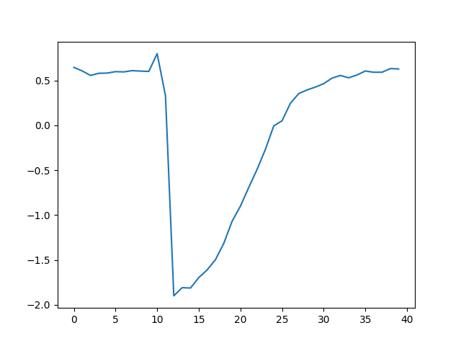
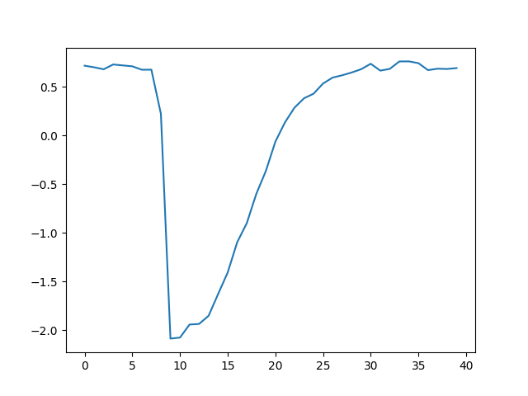
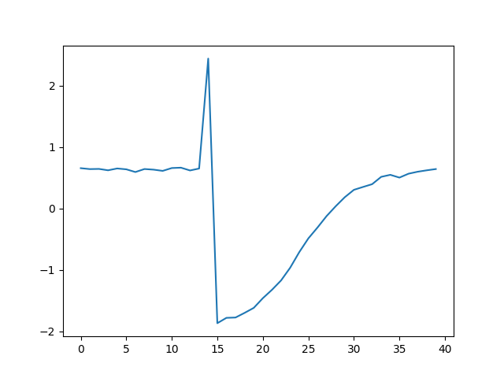
K-Means in action (K=3)
Target: find the best partition.

Slide 5
K-Means in action (K=3)
1. Select K random centroids from time-series.

Slide 6
K-Means in action (K=3)
1. Select K random centroids from time-series.

Slide 7
K-Means in action (K=3)
2. Assign each time-series to its closest centroid.

Slide 8
K-Means in action (K=3)
2. Assign each time-series to its closest centroid.

Slide 9
K-Means in action (K=3)
3. Update new centroids as the means of each group member.

Slide 10
K-Means in action (K=3)
3. Compute new centroids as the means of each group member.
Example group 1.

Slide 11
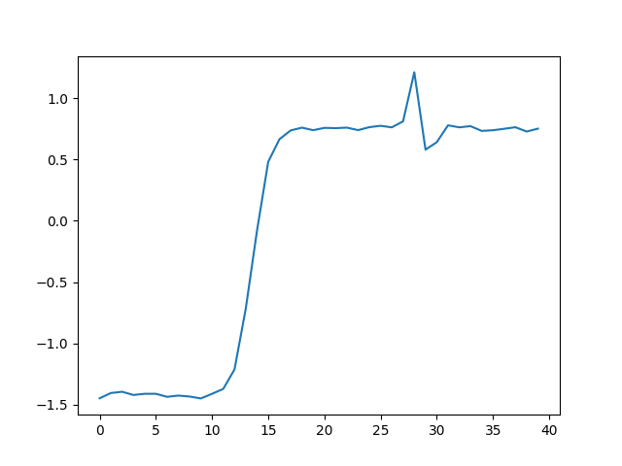
K-Means in action (K=3)
3. Compute new centroids as the means of each group member.
Example group 1.
3

Slide 12
K-Means in action (K=3)
3. Compute new centroids as the means of each group member.
Example group 1.
3

Slide 13
K-Means in action (K=3)
We repeat this process until we reach convergence or compute the max number of steps (iterations).

Slide 14
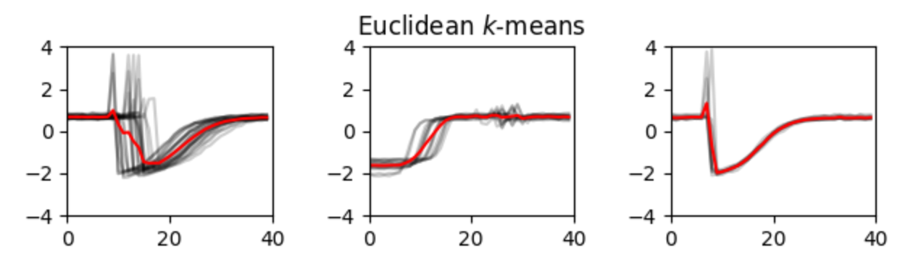
K-Means: Summary
k-Means works nicely with well differentiated time-series like group 2. However, it suffers with similar groups like 1 and 3.
k-Shape comes to rescue.

Slide 15
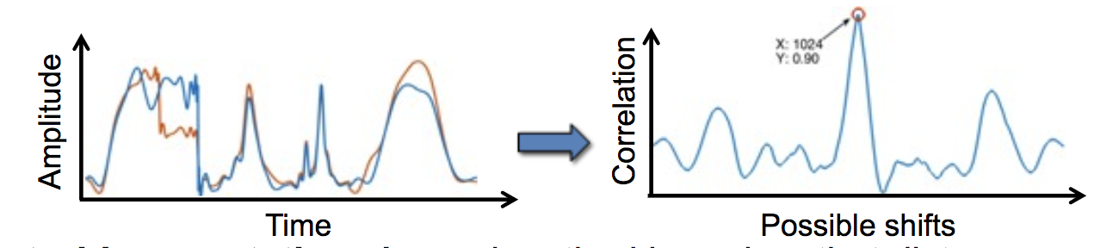
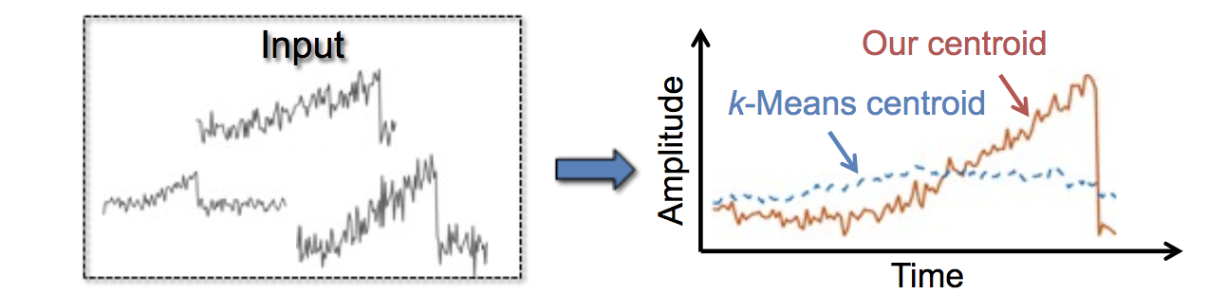
kShape: Introduction
k-Shape uses the k-Means framework.
With a new distance function SBD (normalized cross-correlation).
With a new method to update centroids.
Target: Capture time-series shapes

Slide 16
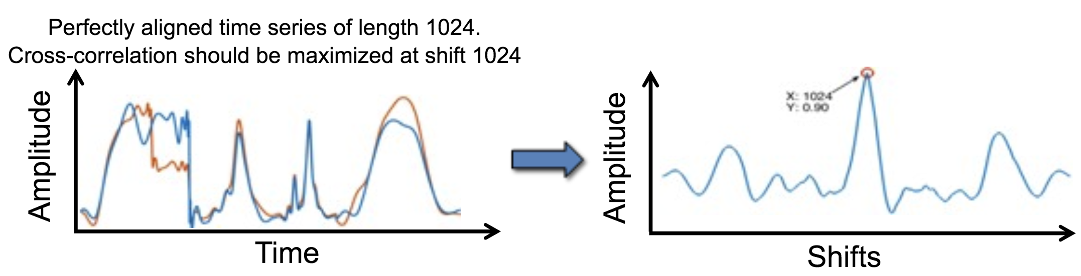
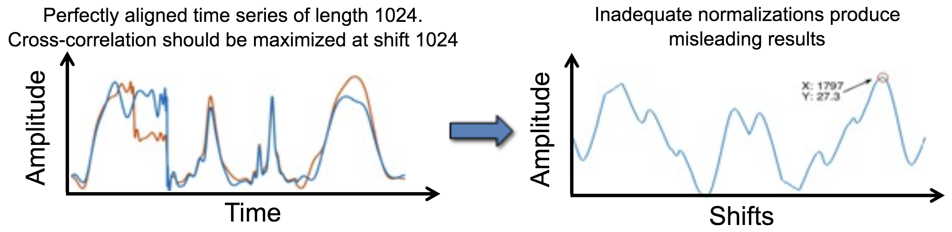
K-Shape: Normalization is key
Key points: Shape Based distance measure (SDB)
Z-normalization
Divide cross-correlation by the product of the 2-norm of the individual time-series.

Slide 17
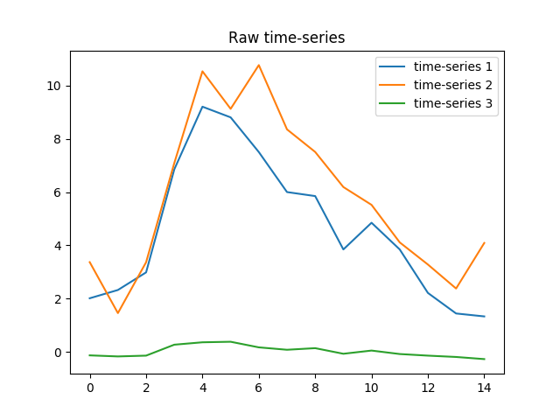
K-Shape: z-normalization in action.
What time-series are similar in shape?

Slide 18
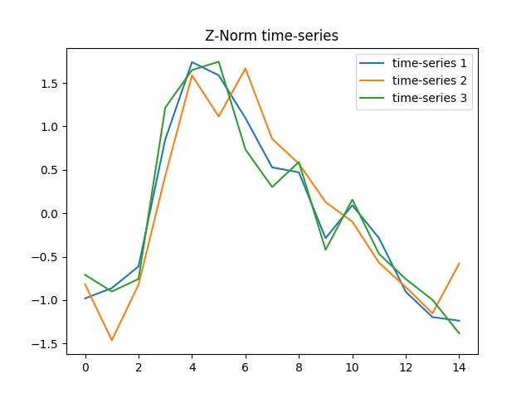
K-Shape: z-normalization in action.
What time-series are similar in shape?
Mean = 0
Stdev= 1

Slide 19
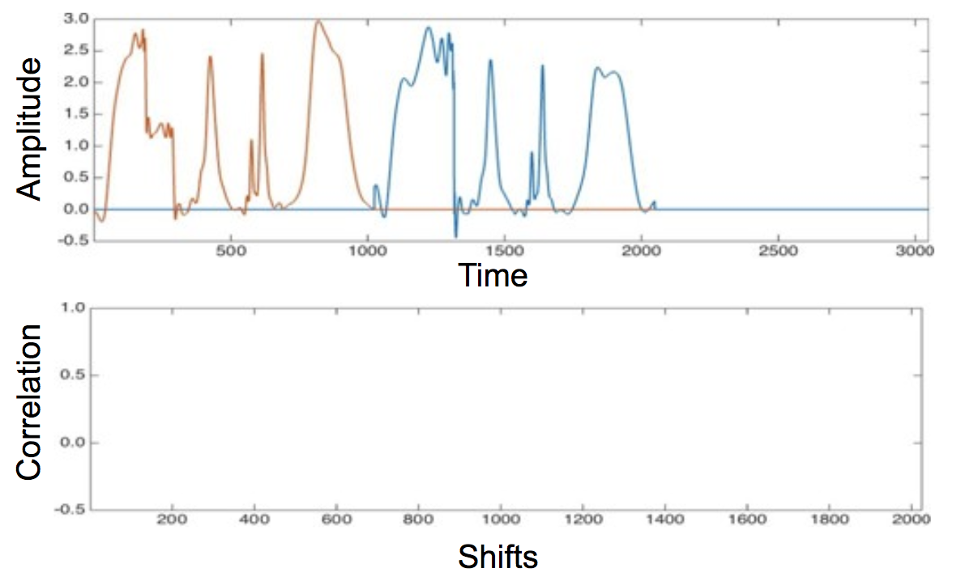
K-shape: Distance function (SBD)
Once time-series are normalized in amplitude, lets find best shift.

Slide 20
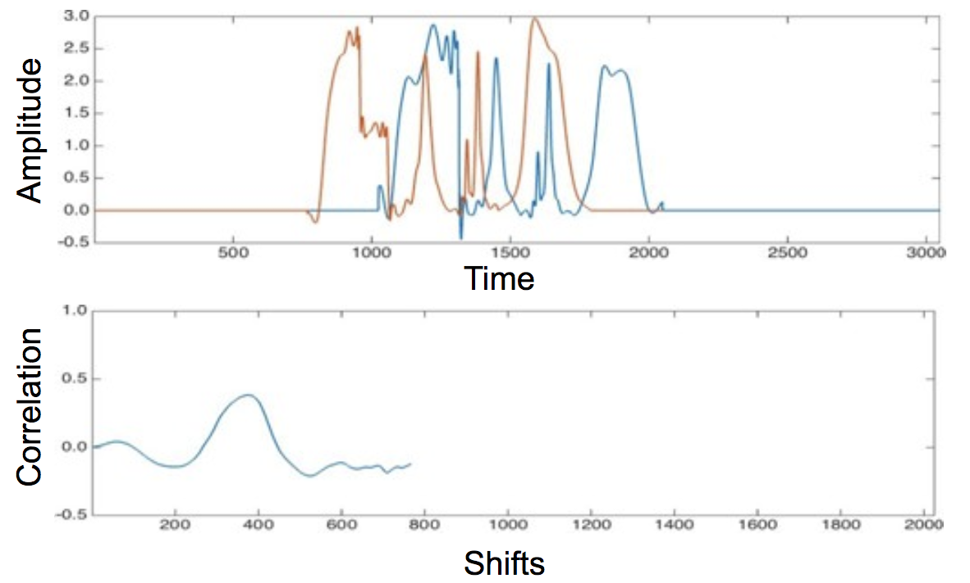
K-shape: Distance function (SBD)
Once time-series are normalized in amplitude, lets find best shift.

Slide 21
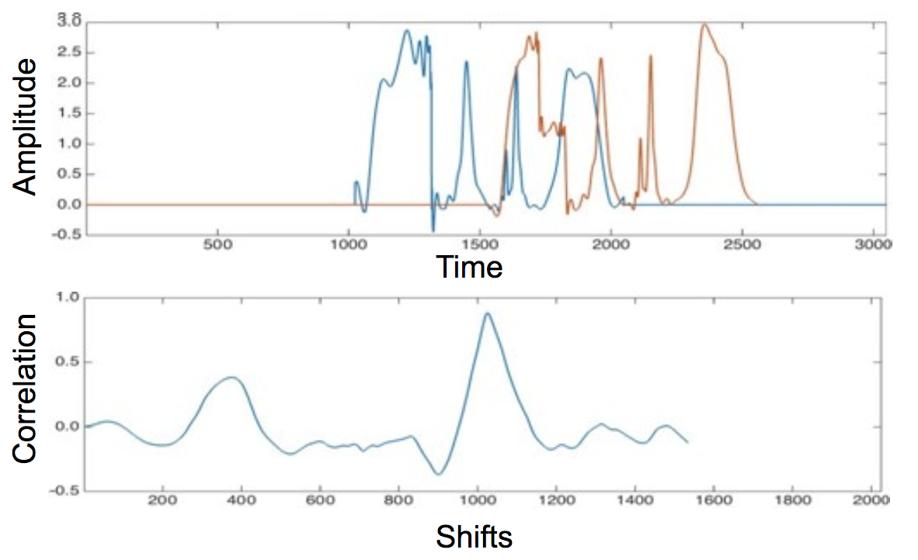
K-shape: Distance function (SBD)
Once time-series are normalized in amplitude, lets find best shift.

Slide 22
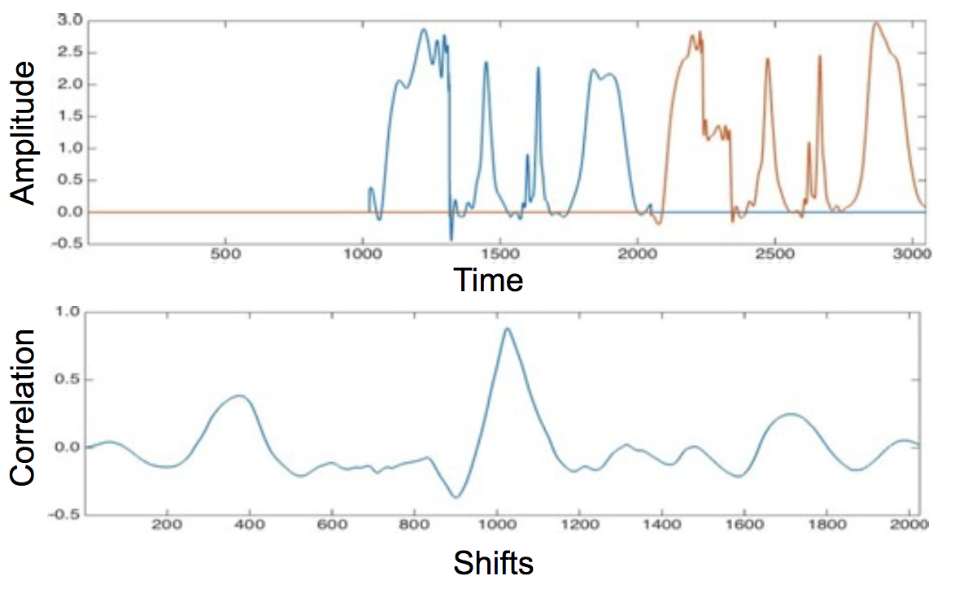
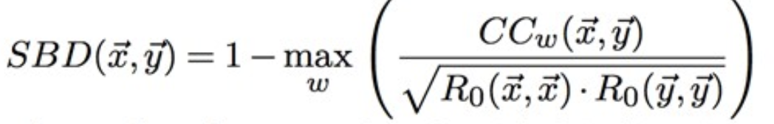
K-shape: Distance function (SBD)
Once time-series are normalized in amplitude, lets find best shift.

Slide 23
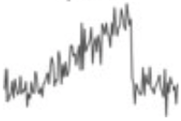
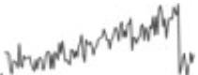
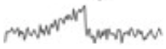
K-Shape: Centroid computation method.
K-Means suffers with misaligned time series.
Centroid computation
First step: Align all time-series.
Second step: Compute the centroid that maximizes
the sum of squared correlations for all time-series in the cluster.

Slide 24
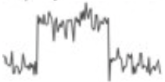
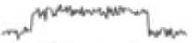
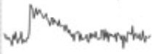
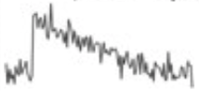

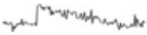
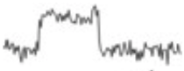
K-Shape in action
Output: k time-series cluster
Group time series into clusters based in their shape similarity (i.e., regardless of any differences in amplitude and phase)

Slide 25
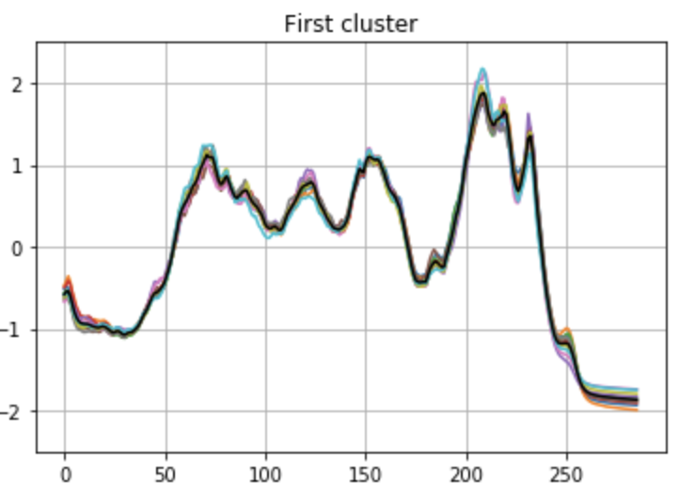
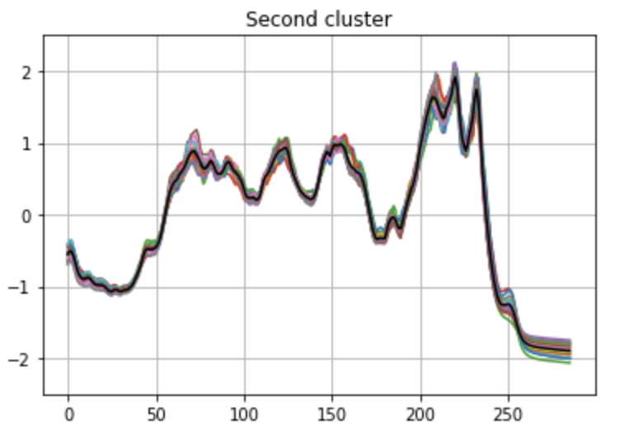
k-Shape summary
Captures the zones that represent the differences between different classes of time-series.
Coffee-beans use-case, available in the notebooks folder

